Slide 1
Advanced COBOL Statements
Inspect, String & Unstring statements

Slide 2
OBJECTIVES
Introduction to Advanced COBOL statements
INSPECT statement
  TALLYING
  REPLACING
  CONVERTING
STRING statement
UNSTRING statement

Slide 3
INSPECT
INSPECT scans the Source String from left to right counting and/or replacing characters under the control of TALLYING, REPLACING or CONVERTING phrases
Behavior of INSPECT is modified by using the LEADING, FIRST,BEFORE & AFTER phrases
An ALL, LEADING, FIRST, CHARACTERS or CONVERTING phrase may only be followed by one BEFORE & one AFTER phrase

Slide 4
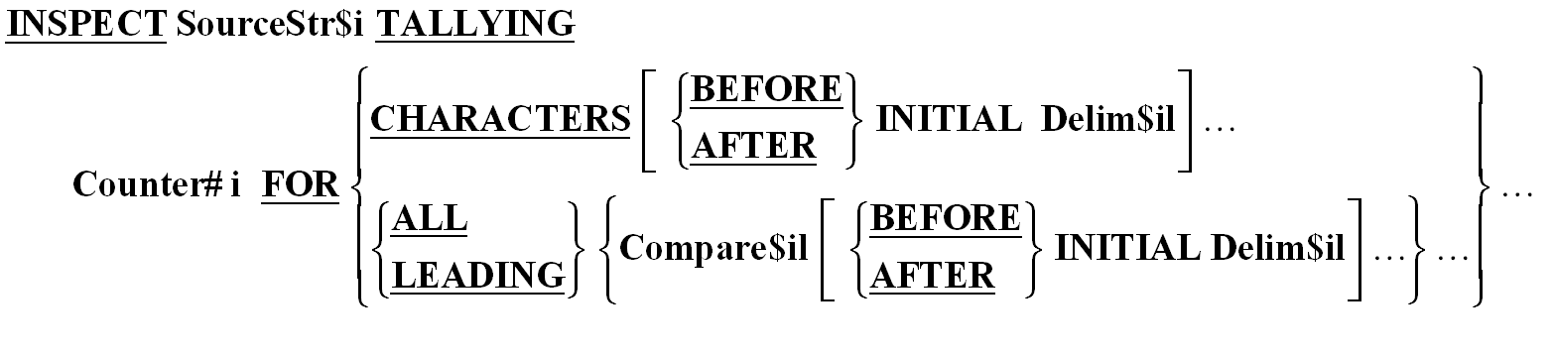
INSPECT TALLYING Syntax
INSPECT Sourcestring1 TALLYING ECount
FOR ALL "e" AFTER INITIAL "start"
BEFORE INITIAL "end".

Slide 5
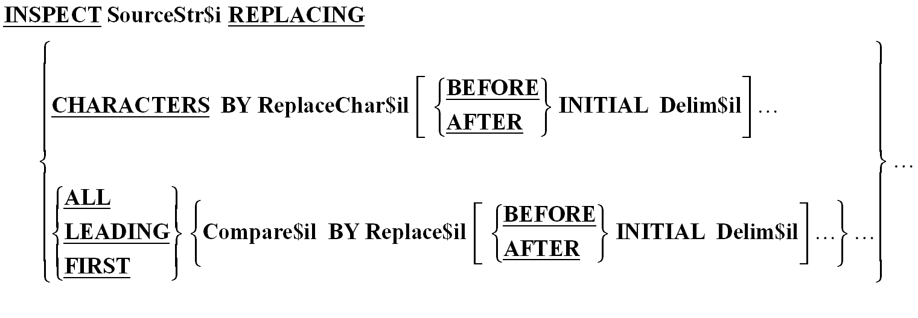
INSPECT REPLACING Syntax
INSPECT Data1 REPLACING ALL “F" BY “O"

Slide 6
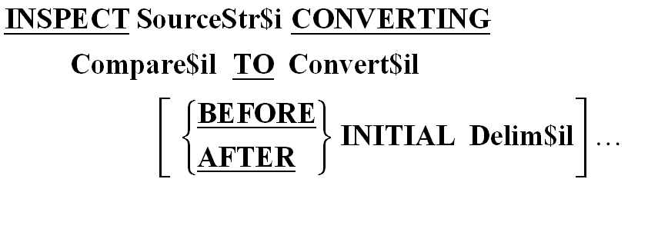
INSPECT CONVERTING Syntax
INSPECT Text1 CONVERTING
“OELVD" TO “RGBAE"

Slide 7
Modifying Phrases
LEADING – counts/replaces all Compare$il characters from the first valid one encountered to the first invalid one
FIRST – replaces only the first valid character
BEFORE – designates characters to the left of delimiter as valid
AFTER – designates characters to the right of delimiter as valid

Slide 8
INSPECT Examples
INSPECT String1 REPLACING ALL “F” BY “O” AFTER INITIAL “A” BEFORE INITIAL “B”
String1: FFFAFFFFFBFFFG
String1: FFFAOOOOOBFFFG

Slide 9
INSPECT Examples
INSPECT String2 REPLACING LEADING “F” BY “O” AFTER INITIAL “A” BEFORE INITIAL “G”
String2: FFFAFFFFFBFFFG
String2: FFFAOOOOOBFFFG

Slide 10
INSPECT Examples
INSPECT String3 REPLACING ALL “F” BY “O”
AFTER INITIAL “A” BEFORE INITIAL “G”
String3: FFFAFFFFFBFFFG
String3: FFFAOOOOOBOOOG

Slide 11
INSPECT Examples
INSPECT String4 REPLACING FIRST “F” BY “O”
AFTER INITIAL “A” BEFORE INITIAL “B”
String4: FFFAFFFFFBFFFG
String4: FFFAOFFFFBOOOG

Slide 12
INSPECT Examples
INSPECT String5 REPLACING “ABC” BY “XYZ”
String5 : ABC123AAA
String5 : XYZ123AAA
INSPECT String6 CONVERTING “ABC” BY “XYZ”
String6 : ABC123AAA
String6 : XYZ123XXX

Slide 13
INSPECT Examples
01 Russia-Salary PIC $$$,$$$,$$9.99
MOVE 12345.90 to Russia-Salary
INSPECT Russia-Salary REPLACING ALL “$” BY “R”
Display Russia-Salary “roubles”
Russia-Salary : R12,345.89 roubles

Slide 14
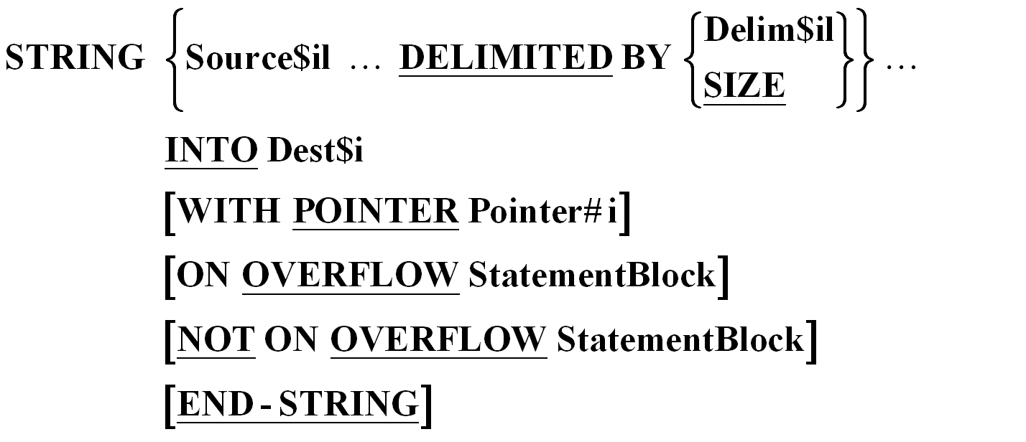
STRING
STRING Ident1 DELIMITED BY SIZE
Ident2 DELIMITED BY SPACES
INTO Ident3
END-STRING.

Slide 15
How STRING works?
STRING statement is used to concatenate several data items into one
Moves characters from source string into destination string from left to right. But no space filling occurs
When there are number of source strings, characters are moved from the leftmost source string first
When a WITH POINTER phrase is used its value determines the starting character position for insertion into destination string
ON OVERFLOW clause executes if there are still valid characters in source string but destination string is full

Slide 16
STRING Examples
Example : 10-Digit TELEPHONE is 8001245897
01 TELEPHONE.
05 AREA-CODE PIC 9(3).
05 LOCAL-NUM PIC 9(7).
01 PRETTY-TELEPHONE PIC X(20) VALUE ALL SPACES.
STRING
“(“ DELIMITED BY SIZE
AREA-CODE DELIMTED BY SIZE
“)” DELIMITED BY SIZE
LOCAL-NUM (1:3) DELIMITED BY SIZE
“-” DELIMITED BY SIZE
LOCAL-NUM (4:4) DELIMITED BY SIZE
INTO PRETTY-TELEPHONE
END-STRING.
PRETTY-TELEPHONE : (800)124-5897

Slide 17
STRING Examples
MOVE 1 TO STRPTR
STRING “(“ DELIMITED BY SIZE
AREA-CODE DELIMITED BY SIZE
INTO PRETTY-TELEPHONE WITH POINTER STRPTR
END-STRING.
STRING “)” DELIMITED BY SIZE
LOCAL-NUM (1:3) DELIMITED BY SIZE
INTO PRETTY-TELEPHONE WITH POINTER STRPTR
END-STRING.
STRING “-” DELIMITED BY SIZE
LOCAL-NUM (4:4) DELIMITED BY SIZE
INTO PRETTY-TELEPHONE WITH POINTER STRPTR
END-STRING.
PRETTY-TELEPHONE : (800)-124-5897

Slide 18
STRING Examples
01 Source-String
05 Field1 PIC X(18) VALUE “WHERE DOES THIS GO”.
05 Field2 PIC x(30) VALUE “THIS IS THE DESTINATION STRING”.
STRING Field1 DELIMITED BY SPACES
INTO Field2
END-STRING.
DISPLAY Field2.
Field2 : WHEREIS THE DESTINATION STRING

Slide 19
STRING Examples
STRING Field1 DELIMITED BY SIZE
INTO Field2
END-STRING.
DISPLAY Field2.
Field2 : WHERE DOES THIS GOATION STRING
MOVE 6 TO STRPTR
STRING Field1 DELIMITED BY SIZE
INTO Field2 WITH POINTER STRPTR
END-STRING.
DISPLAY Field2.
Field2 : THIS WHERE DOES THIS GO STRING

Slide 20
STRING Examples
MOVE 15 TO STRPTR
STRING Field1 DELIMITED BY SIZE
INTO Field2 WITH POINTER STRPTR
ON OVERFLOW DISPLAY “STRING ERROR”
NOT ON OVERFLOW DISPLAY Field2
END-STRING.
Answer : STRING ERROR

Slide 21
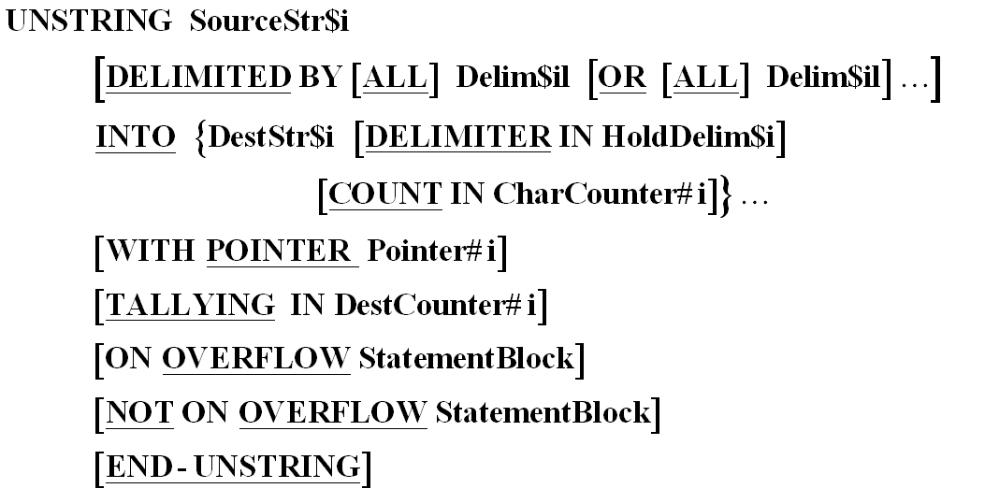
UNSTRING
UNSTRING FullName DELIMITED BY ALL SPACES
INTO FirstName, SecondName, Surname
END-UNSTRING

Slide 22
How UNSTRING Works?
UNSTRING statement is used to split a single data item into several data items
Copies characters from source string to destination string until a delimiter is encountered in source string or destination string is full
When either of these things happen, the next destination string becomes the receiving area and characters are copied into it till it is full or another delimiter is encountered in the source string
Characters are copied from source string to destination string according to the rules of alphanumeric moves and no space filling
When TALLYING phrase is used, the field count field contains a value equal to initial value, plus the number of data receiving areas acted upon
UNSTRING terminates when all characters in source string have been examined OR all destination strings have been processed OR some error condition is encountered

Slide 23
UNSTRING Clauses
ON OVERFLOW
ON OVERFLOW is activated if –
    The unstring pointer is pointing to character position within the source string when UNSTRING executes
    All destination strings have been examined but there are still unexamined characters in source string
COUNT IN
Associated with a particular destination string and holds the count of number of characters passed to destination string

Slide 24
UNSTRING Clauses
DELIMITER IN
Associated with particular destination string. HoldDelim$i holds the delimiter encountered in the source string
WITH POINTER
Holds the position of next delimiter character to be examined in source string. Must be large enough to hold value one greater than size of source string

Slide 25
UNSTRING Examples
01 ADRESS1 PIC X(84) VALUE “ACCENTURE – MUMBAI DELIVERY CENTRE; PLANT-9, GODREJ INDUSTRIAL COMPLEX; VIKHROLI (W)”.
01 ADDRESS2.
05 LINE1 PIC X(80).
05 LINE2 PIC X(80).
05 LINE3 PIC X(80).
UNSTRING ADDRESS1 DELIMITED BY “;”
INTO LINE1 LINE2 LINE3
END-UNSTRING.
LINE1 : ACCENTURE – MUMBAI DELIVERY CENTRE
LINE2 : PLANT-9, GODREJ INDUSTRIAL COMPLEX
LINE3 : VIKHROLI(W)

Slide 26
UNSTRING Examples
01 DATESTR PIC X(10) VALUE “12-01/2004”
01 DESTDATE.
05 DAY PIC X(2).
05 MONTH PIC X(2).
05 YEAR PIC X(4).
UNSTRING DATESTR DELIMITED BY “-” OR “/”
INTO DAY DELIMITER IN Hold1
MONTH DELIMITER IN Hold2
YEAR
END-UNSTRING.
DISPLAY DAY SPACE MONTH SPACE YEAR
DISPLAY Hold1 SPACE Hold2
12 01 2004
- /

Slide 27
UNSTRING Examples
01 DATESTR PIC X(12) VALUE “12//01//2004”
01 DESTDATE.
05 DAY PIC X(2).
05 MONTH PIC X(2).
05 YEAR PIC X(4).
UNSTRING DATESTR DELIMITED BY “/”
INTO DAY MONTH YEAR
ON OVERFLOW DISPLAY “ CHARS LEFT”
END-UNSTRING.
CHARS LEFT

Slide 28
UNSTRING Examples
01 DATESTR PIC X(12) VALUE “12//01//2004”
01 DESTDATE.
05 DAY PIC X(2).
05 MONTH PIC X(2).
05 YEAR PIC X(4).
UNSTRING DATESTR DELIMITED BY ALL “/”
INTO DAY MONTH YEAR
ON OVERFLOW DISPLAY “ CHARS LEFT”
END-UNSTRING.
12 01 2004

Slide 29
Thank you!

